Slide 1
C-DAC COMPUTER 87,PLATINUM PLAZA NIKOL AHMEDABAD-382350
Our courses:
CCC
C LANGUAGE
C++
JAVA
JAVA SCRIPT
PNP
JAVA SCRIPT

Slide 2
TYPES OF SUBJECT
TYPES:
MATHS
HINDI
SANSKRIT
SCIENCE
MATHS
ENGLISH
OUR EDUCATION SYSTEM CONSISTS OF SO MANY SUBJECT ALL HAVE ITS SPECALITY AND DIFFERENT CONTENTS SO ALL SUBECTS ARE IMPORTANT.
BUT AFTER 10TH STANDARD THE SUBJECTS WILL BE DIVIDED AND ONLY 2 SECTION:1)SCIENCE AND (2)COMMERCE.

Slide 3
SPORTS GAMES
THERE ARE SO MANY TYPES OF GAMES IN THE WHOLE WORLD.
ALL HAVE DIFFERENT TYPES OF RULES AND THAT DIFFERS FROM EACH OTHER.
TO PLAY ALL THE GAMES THERE ARE DIFFERENT ACCESSIORIES AVAILABLE TO PLAY.
TO PLAY, FIRST YOU HAVE TO LEARN THE BASICS OF GAMES.
TYPES OF GAMES:
CRICKET
HOCKEY
BASKETBALL
VOLLEYBALL
TENNIS
BADMINTON
FOOTBALL

Slide 4
SOCIAL PROBLEMS
TERRORISM
REBELION
IT IS A PROBLEM OF WHOLE WORLD.
IT OCCURS AGAINST OTHER COUNTRIES.
IT DOESN’T GET LOCAL SUPPORT.
IT IS A PROBLEM IN A PARTICULAR COUNTRY OR A STATE.
IT OCCURS AGAINST ITS OWN GOVERNMENT.
IT CAN GET LOCAL SUPPORT OR IT CAN’T.

Slide 5
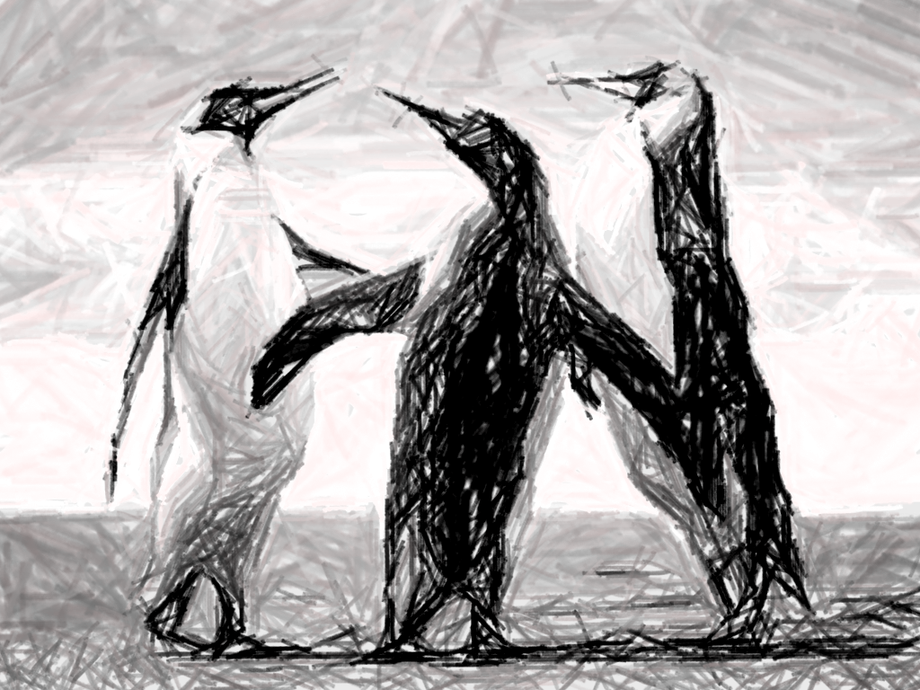
PENGUINS
PENGUINS ARE ONE TYPES OF BIRDS AND IT IS A BIRD THAT CAN SWIN BUT CAN’T FLY.
PENGUINS MAINLY FOUND IN NORTHERN REGION.
THEY HAVE LON BEAK AND A YELLOW SPOT ON BETWEEN HEAD.
THEY HAVE TWO FLAPPY WINGS THAT HELPS THEM TO SWIM EASILY.
THEY ARE MAMMALS.

Slide 6
CARRER
AFTE 10TH THERE WILL SO MANY OPTIONS BUT THERE WILL BE ONLY 2 STREAMS. EITHER SCIENCE OR COMMERCE.
IF YOU ARE INTERESTED IN BANK WORK THEN GO FOA COMMERECE STREAM.OR IF YOU WANT TO BECOME AN ENGEENIER OR WANTS TO BECOME A DOCTOE THEN GO FOR SCINCE STREAM.
TILL ST 10TH THERE IS A NORMAL STUDIES BUT AFTER 10TH THE MOST IMPORTANT QUESTION IS TO CHOOSE WHICH PERFECT STEP OR CARRER OF THE LIFE THAT MAKES OUR LIFE SUCCESSFUL.
AFTE 10TH THERE WILL BE 2 OPTION THAT IS SCIENCE OR COMMERCE.

Slide 7
PUBG-A MOBILE AND PC GAME
THE FULLFORM OF PUBG IS PLAYER’S UNKNOWN BATTLEGROUND.
IT IS A GAME THAT GETS POPULARITY IN VARY SHORT TIME LIKE IN 4 OR 5 MONTHS.
THEY HAVE EARNED 7100 CRORES AND DONE 2100 CRORES PROFIT FROM THAT.
IT IS AN ACTION GAME.
THERE ARE TOTAL 100 PLAYERS IN AN AIRPLANE AND IT IS ALL PLAYER’S UNKNOWN BATTLEGROUND THAT THEY DOESN’T KNOW WHO THEY WILL KILL AND WHO WILL KILL HIM OR HER.
IT’S ALL FUN TO PLAY THIS BATTLEFROUND GAME.
IT HAS RELAISTIC GRAPHICS AND VERY GOOD CONTENT.

Slide 8
SUBJECTS
SCIENCE
MATHS
IT IS THE SUBJECT WHICH CONTAINS ALL THE SCIENCE RELATED TOPICS.
IT CONTAINS EXPERIMENTS,DIFFERENT FORMULAS AND 70% INTERESTING TOPICS
IT IS SOMEHOW A BORING SUBJECT.
IT IS THE SUBJECT WHICH IS HATED BY 60% OF STUDENTS.
IT CONTAINS THEORIES,FORMULAS,DIFFERENT THEOREMS THAT BORES.
IT IS ALSO A BORING SUBJECT BESAUSE IT THE DIFFERENT TYPES OF SUMS SUCKS MIND.

Slide 9

WILDLIFE
WILDLIFE IS AN IMPORTANT LIFE TO BALANCE THE ECOSYATEM.
WILD LFE AND HUMAN LIFE MIXES AND MAKEA A BALANCED ECOSYSTEM.
IF ECOSYSTEM IS DISTURBED THEN WE WLL IN THE PROBLEM.
WE HUMAN ARE DESTROYING THEIR HOMES Ie. FORESTS
WE DESTROY THEIR HOMES TO BUILD OUY HOMES.
DUE TO THIS TODAY OUR WILDLIFE IS IN DANGER SO MANY ANIMALSA ARE DYING.

